Slide 1



SQL PROJECT
Presentation 2023
E-COMMERCE ANALYSIS

Slide 2

CONTENT
01
Description:
02
Business Objectives:
03
E-Commerce Data Statistics and Growth Potential
04
Data cleaning
05
Data modification

Slide 3

Description:
"SQL Analysis of E-Commerce Dataset: Unveiling Insights from Product Information"
Join us on a data-driven journey through e-commerce as we analyze a diverse dataset containing product information, including laptops,cameras, and electronics. With over 20 years of SQL expertise, we extract and explore this data to uncover valuable insights, from data preprocessing to actionable findings.

Slide 4






OBJECTIVES
"SQL Analysis of E-Commerce Dataset: Unveiling Insights from Product Information"
Join us on a data-driven journey through e-commerce as we analyze a diverse dataset containing product information, including laptops, cameras, and electronics.
we extract and explore this data to uncover valuable insights, from data preprocessing to actionable findings.
E-Commerce

Slide 5


E-COMMERCE DATA STATISTICS AND GROWTH POTENTIAL
Annually, the e-commerce industry generates an estimated 1.3 trillion gigabytes (1.3 zettabytes) of data.
This data encompasses product information, customer behavior, and transactional details.
Analyzing this data can uncover customer preferences, purchasing patterns, and emerging market trends.
Informed decisions based on data insights can drive personalized marketing, optimized supply chains, and enhanced customer experiences.

Slide 6
E-COMMERCE DATA STATISTICS AND GROWTH POTENTIAL
By 2025, companies using data-driven strategies are projected to generate $1.2 trillion in additional revenue compared to their peers. Our Journey
In our analysis, we dive deep into this sea of data, using SQL to extract valuable information for strategic decision-making.
Let's explore how leveraging data can fuel the growth of our organization in the e-commerce landscape.

Slide 7
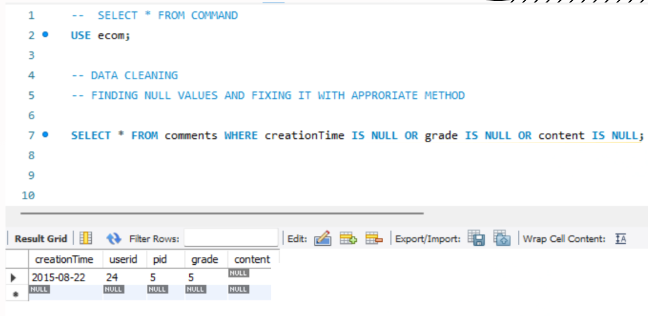
DATA CLEANING
Q1. Find null values and fix them with appropriate method.

Slide 8
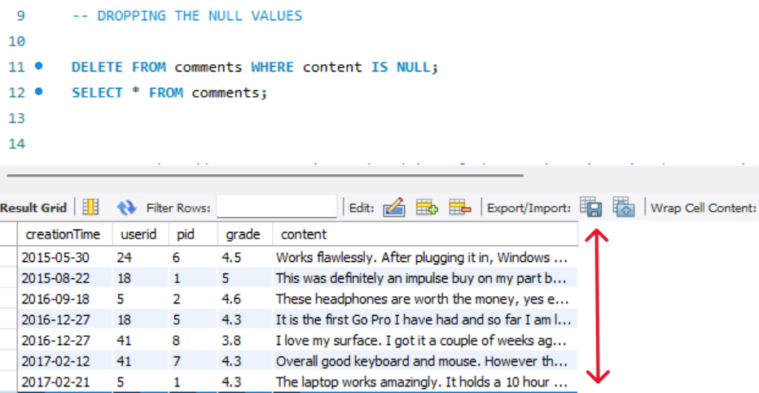
DATA CLEANING
Q2. DROPPING THE NULL VALUES

Slide 9
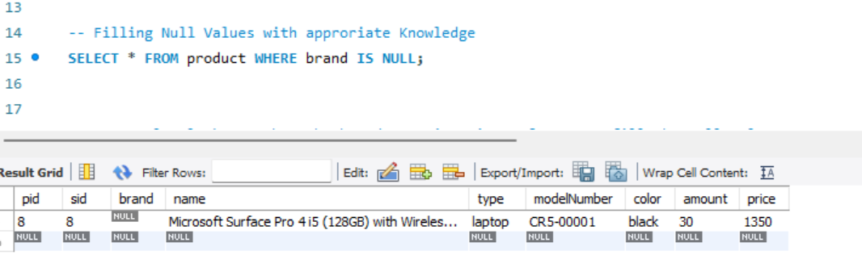
DATA CLEANING
Q3. Filling Null Values with approriate Knowledge.

Slide 10
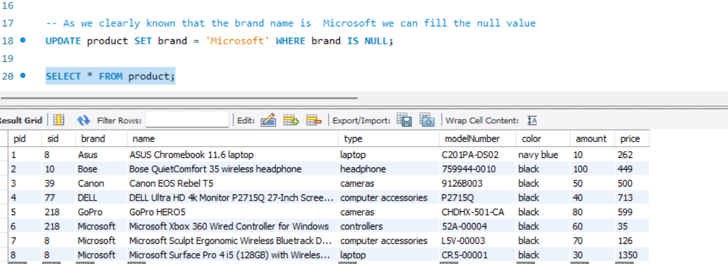
DATA CLEANING
Q4. As we clearly known that the brand name is Microsoft we can fill the null value

Slide 11
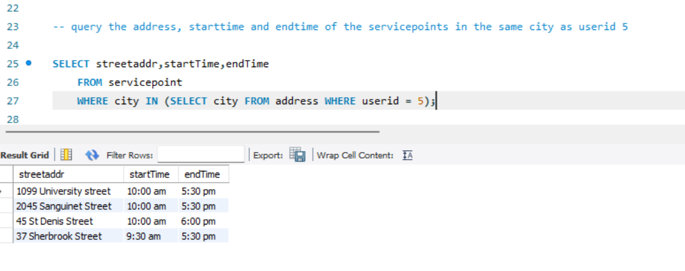
DATA CLEANING
Q5. query the address, starttime and endtime of the servicepoints in the same city as userid 5

Slide 12
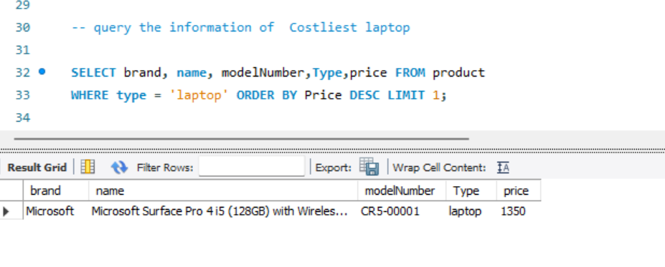
DATA CLEANING
Q6. query the information of Costliest laptop

Slide 13
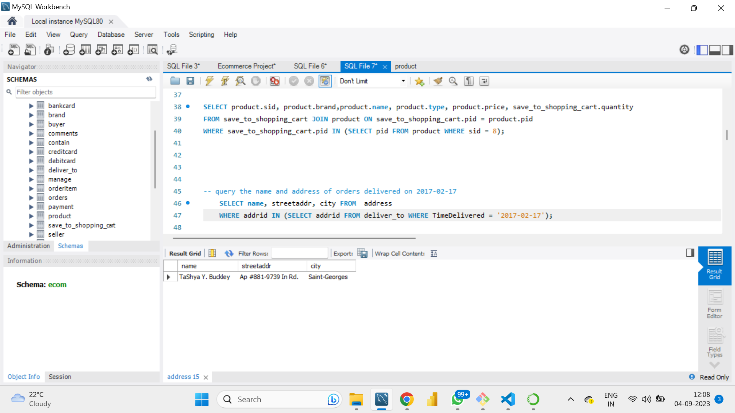
DATA CLEANING
Q7. Query the total quantity of products from store with storeid 8 in the shopping car

Slide 14
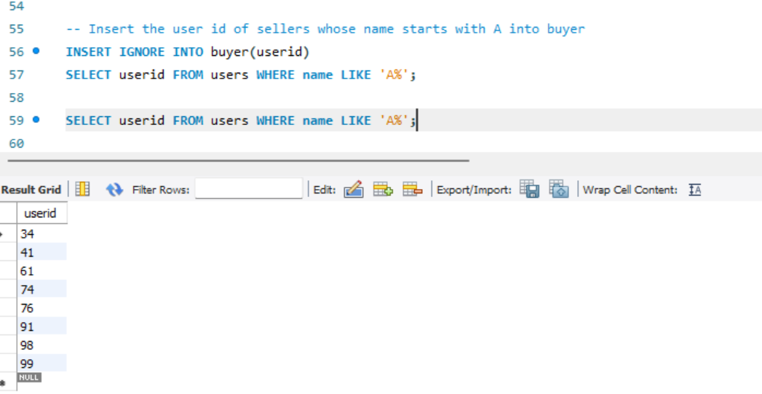
DATA CLEANING
Q8. Query the name and address of orders delivered on 2017-02-17

Slide 15
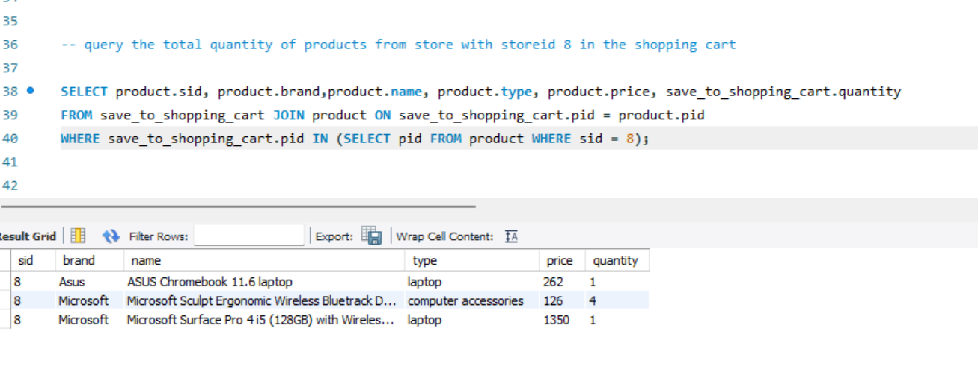
DATA MODIFICATION
Q9.Insert the user id of sellers whose name starts with A into buyer

Slide 16
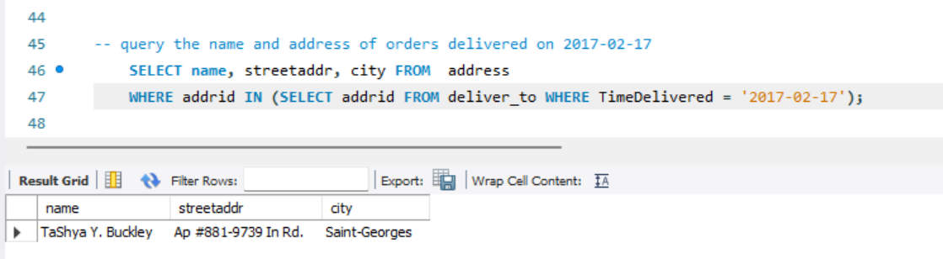
DATA MODIFICATION
Q10. Update the payment state of orders to unpaid which created after year 2017 and with total amount greater than 50.

Slide 17
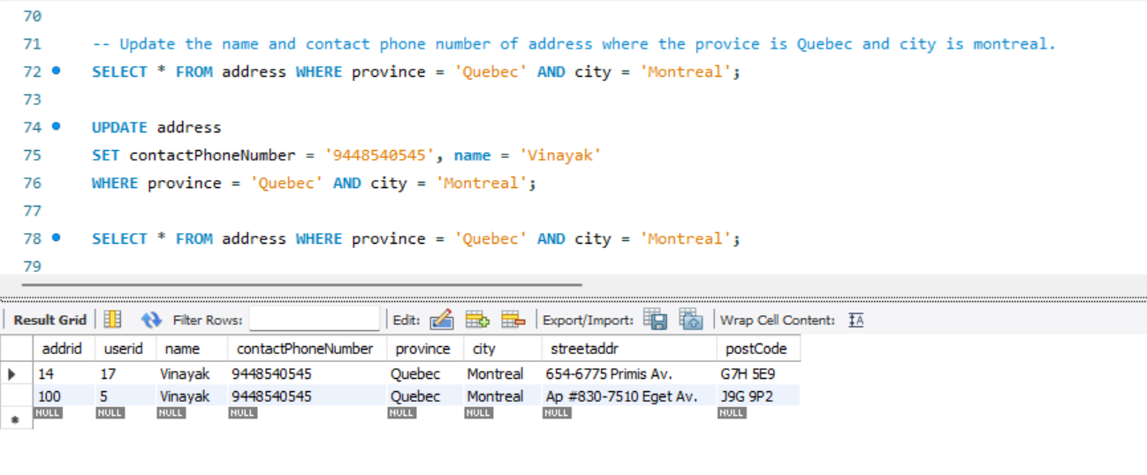
DATA MODIFICATION
Q11. Update the name and contact phone number of address where the provice is Quebec and city is montreal.

Slide 18
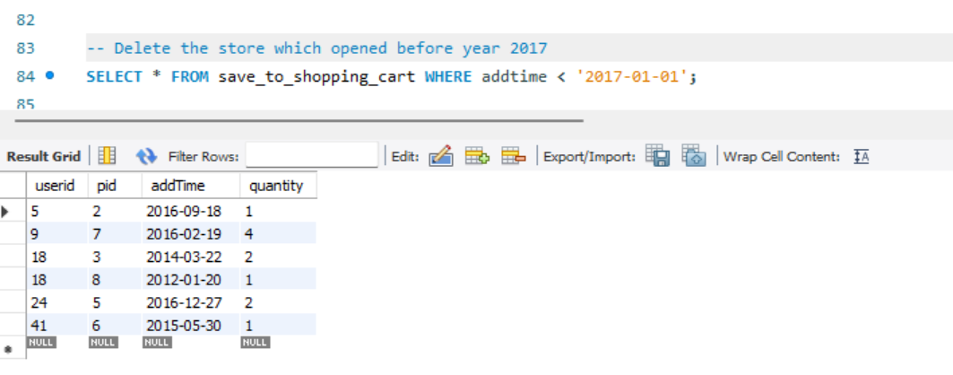
DATA MODIFICATION
Q12. Delete the store which opened before year 2017

Slide 19




PRESENTED BY:
Vinayak
Shivanagutti
Data Analyst

Slide 20

E-Commerce
THANK YOU
Notes:
hi i'm Shivaprasad

